Slide 1
Flood prediction and crisis management
Mrinal Jha
Murlikrishnan Tripathi
Anshuman Pati

Slide 2
Overview
Thousands of human lives are lost every year around the earth as well as significant damage to property, animal life, etc. to natural disasters (e.g. earthquake, flood, tsunami, cyclones, etc.). The main of our project is the application of data mining and AI Algorithms for
i) prediction of disaster
ii) identifying appropriate disaster management techniques based on the collected data from the social media.

Slide 3
Broad Category of tasks related to Flood Crisis Management
01
Prediction: These set of tasks involve prediction of flood from previous available data using features like precipitation amount, time frames of previous occurrences.
02
Mangagement Strategies: These set of tasks are involved in forming appropriate management strategies. For example, identifying the critical entities for managment, proper communication study, needs of flood affected area. Social media plays a very important part in this task.

Slide 4
Flood Prediction (AI pipeline)
Here we have developed a AI pipeline involving RNN and Logistic Regression.
Data → RNN → Logistic Regression → Flood Prediction for next month

Slide 5
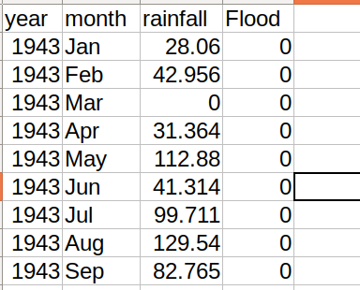
Flood Prediction - DATASET
Here we take dataset of monthly rainfall and flood occurence data of Chennai from 1943 to 2016.

Slide 6
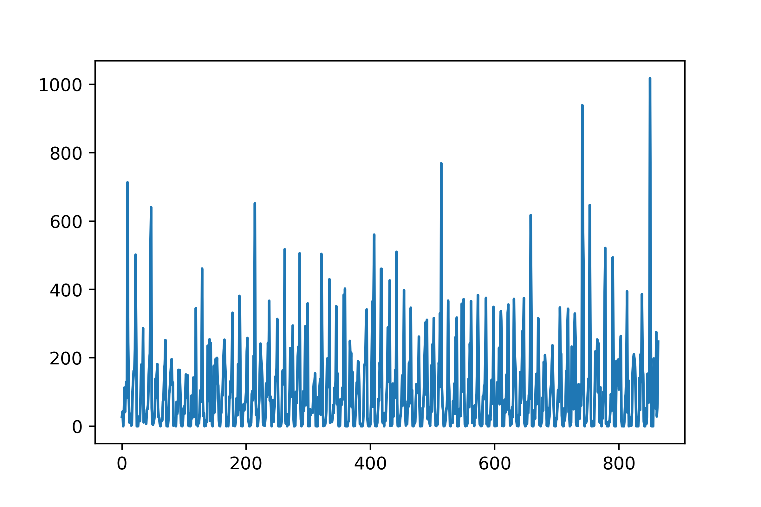
Flood Prediction -DATASET
Here we take dataset of monthly rainfall and flood occurrence data of Chennai from 1943 to 2016.
This corresponds to rainfall data in dataset

Slide 7
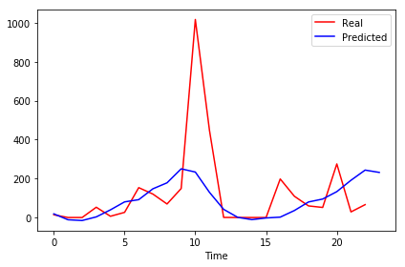
Flood Prediction -RNN (12-Timestep)
After training on RNN for all years except for 2015-2016 years, we tested it for 2015-2016 data to predict rainfall data for next month.

Slide 8
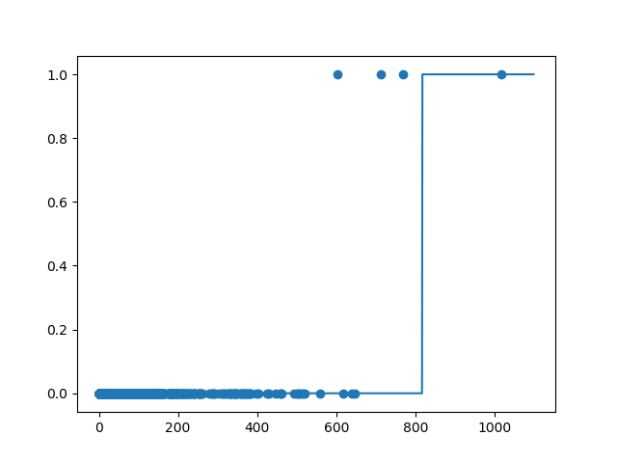
Flood Prediction - Logistic Classifier
Also separate Logistic Classifier was trained on all years of flood occurrences in data except for last two years.

Slide 9
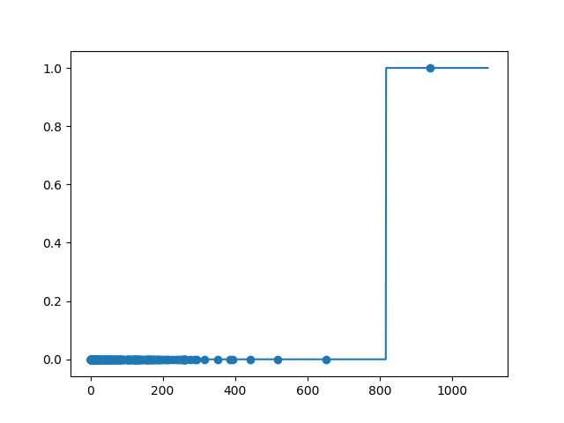
Flood Prediction - Logistic Classifier
And this classifier is also tested on 2015-2016 data. And correct prediction was obtained for 2015 chennai floods

Slide 10
Flood Prediction - Pipeline complete
After obtaining rainfall data for next month from RNN we then pass this data to Logistic Classifier which predicts if flood will happen or not, thus completing the AI pipeline.
Data → RNN → Logistic Classifier → prediction

Slide 11
Flood Prediction - Limitation
The dataset used consisted only of 1 independent variable- precipitation data for RNN.
If variables like cloud cover, temperature, Vapour pressure is also included then, prediction accuracy can be increased.

Slide 12
Flood Prediction - Limitation
The dataset used consisted only of 1 independent variable- precipitation data for RNN.
If variables like cloud cover, temperature, Vapour pressure is also included then, prediction accuracy can be increased.

Slide 13
Disaster Management
The technique used by us in this part is text mining and sentiment analysis. It is a technique used to categorize texts on the basis of opinions conveyed by them like positive, negative or neutral. It would help us to understand the pros and cons of the current disaster management system and how it can be further improved. It also shows the involvment of authority in successfully tackling a disaster.

Slide 14
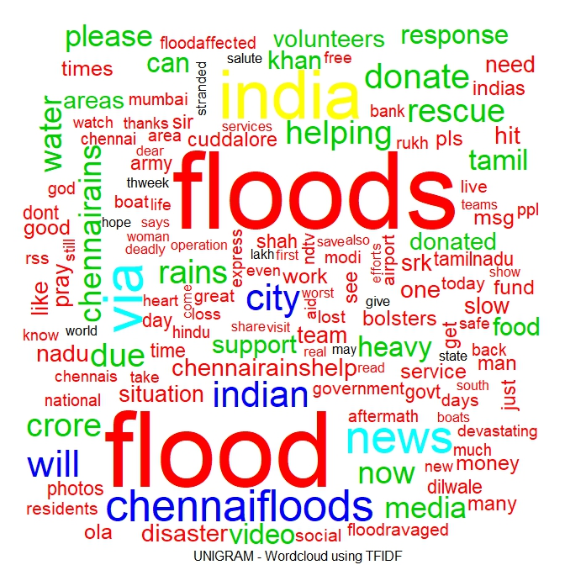
Some plots obtained from the analysis
Wordcloud using TFIDF- short for term frequency inverse document frequency. It is a numerical statistic intended to reflect how important a word is to a document in a collection or corpus of words..

Slide 15
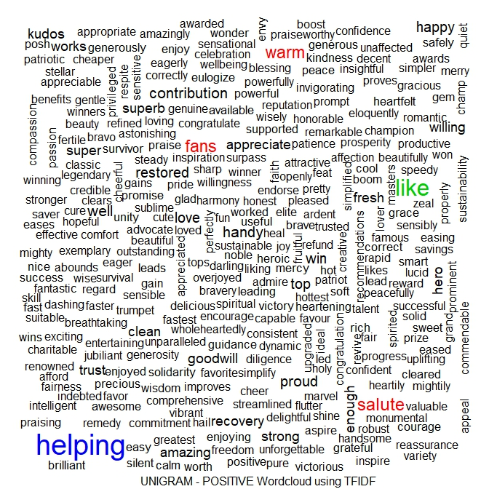
Some plots obtained from the analysis
Positive word cloud obtained after creating a document term matrix. A document matrix is a table containing the frequency of words. Column names are words and row names are documents.

Slide 16
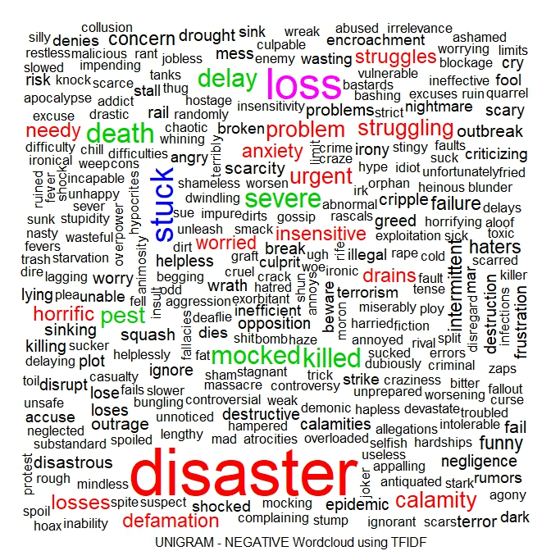
Some plots obtained from the analysis
Negatice word cloud obtained after creating a document term matrix. These word clouds are important as they give a gist of large amount of text in a simple plot. The most used keywords stand out the most in the cloud. Also they are more engaging than a table.

Slide 17
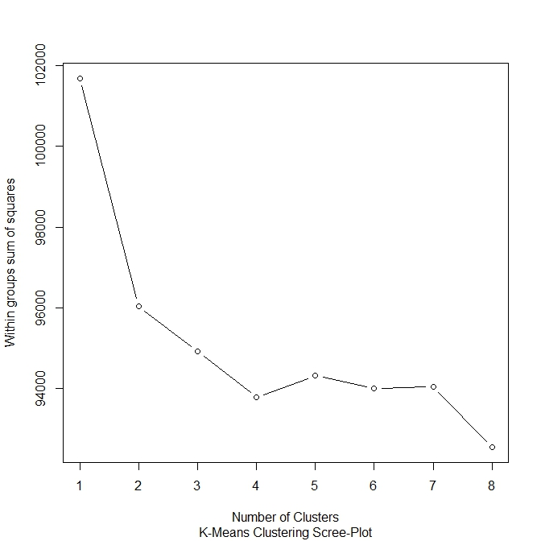
Some plots obtained from the analysis
The k-means clustering scree plot obtained for our analysis of the tweets.
It is also called the elbow plot because the elbow in the plot shows the number of clusters in which the total observations could be divided.

Slide 18
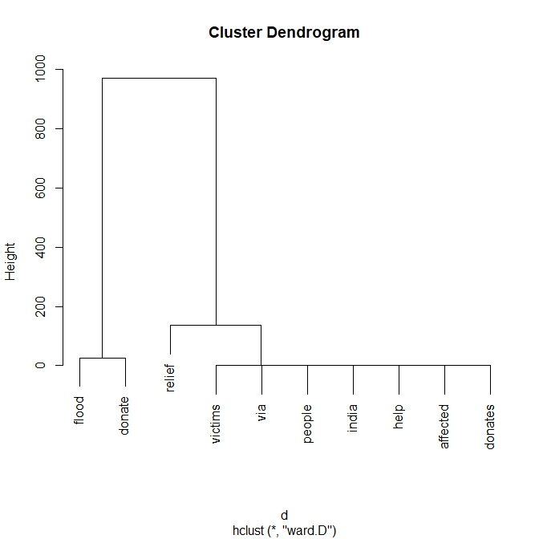
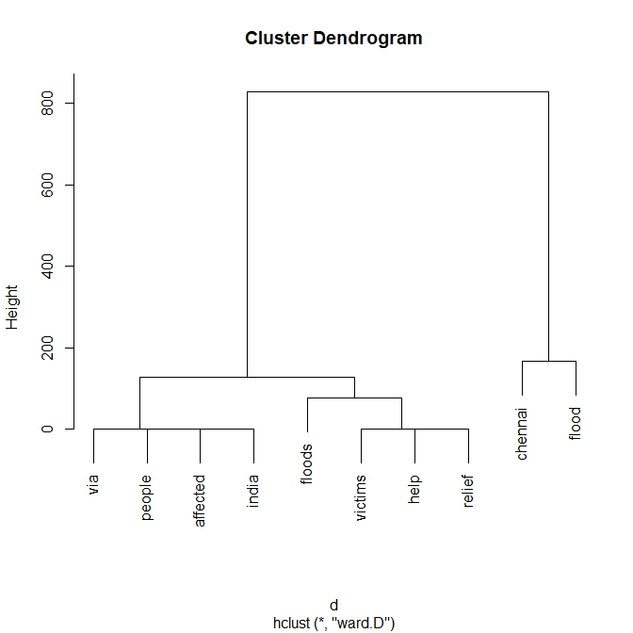
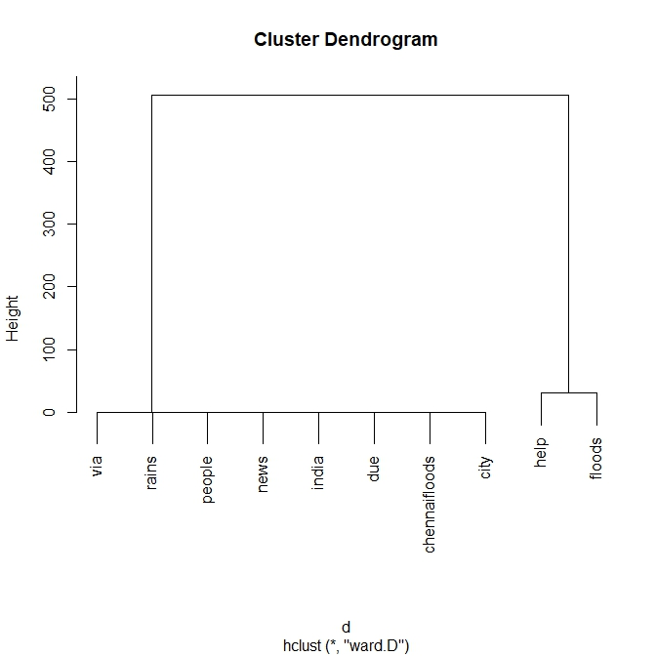
Some plots obtained from the analysis
Cluster Dendograms obtained from our analysis.

Slide 19
THANK YOU

